Slide 1

Unit Testing
Exercises
SoftUni Team
Technical Trainers
Software University
https://softuni.org

Slide 2
Have a Question?
Channel for Communication

Slide 3
Table of Contents
Maven
XML
POM
Junit tests
Mocking

Slide 4
Maven
Used for Java-based projects, helping to download dependencies (libraries or JARs)
https://mvnrepository.com/
Open source
Based on POM (Project Object Model)
POM is written in XML

Slide 5
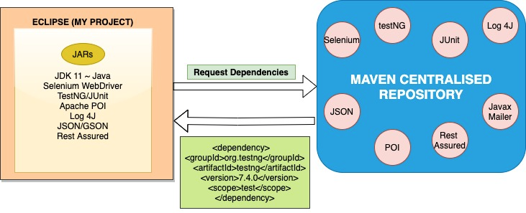
Maven
Source: https://ruchi01.medium.com/maven-architecture-and-life-cycle-9fe6b12cef97

Slide 6
XML
eXtensible Markup Language (XML)
Enabling definition and storing the data in a shareable manner
Enhances interoperability
Document is organized with tags (similar to HTML)
HTML displays data and describes the structure of a webpage, whereas XML stores and transfers data.

Slide 7
XML example
<document>
<documentID>123</documentID>
<documentType>Passport</documentType>
<validUntil>2028-01-01</validUntil>
<Person>
<name>Anne</name>
<surname>Hart</surname>
</Person>
</document>

Slide 8
POM dependency example
<dependency> <groupId>org.testng</groupId> <artifactId>testng</artifactId> <version>7.4.0</version> <scope>test</scope> </dependency>

Slide 9
Testing
Blackbox testing
Whitebox testing
https://www.geeksforgeeks.org/differences-between-black-box-testing-vs-white-box-testing/

Slide 10

How would you test the pen?
A question from the book: Cracking the Coding interview

Slide 11

Testing in a nutshell
Peanutbutter and Jelly Sandwich Instructions

Slide 12
JUnit tests
JUnit test is a method which is only used for testing
Overcomes the need for manual testing
Automation of testing
JUnit test should only test a single aspect of the method (a unit)
Helps avoiding bugs after refactoring

Slide 13
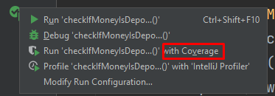
Methods
assertEquals()
assertTrue()
assertFalse()
assertNull()
assertNotNull()
assertThrows()
(expected = …)

Slide 14
Fixtures
Fixed state of a set of objects used as a baseline for running tests.
Ensuring that there is a predefined and fixed environment in which tests are run so that results are repeatable.
setUp() method - before every test invocation
@Before annotation
tearDown() method - is executed after every test method
@After annotation

Slide 15
ATM testing
Checking PIN
Money withdrawal
Money deposit
Current balance
Transfering money

Slide 16
Mocking
Refers to the development of objects which are a mock or clone of real objects
Used when the tests have an external dependency
Usage of mock objects instead of real objects for testing
Provide a specific mock output for each mock input passed (we chose the behaviour that otherwise can be unpredictable)

Slide 17
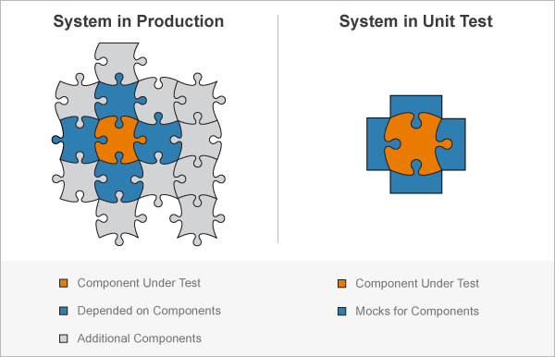
Mocking
Source: https://www.mathworks.com/help/matlab/matlab_prog/create-mock-object.html

Slide 18
Questions?
Notes:
18

Slide 19













SoftUni Diamond Partners

Slide 20

Educational Partners

Slide 21
Trainings @ Software University (SoftUni)
Software University – High-Quality Education, Profession and Job for Software Developers
softuni.bg
Software University @ Facebook
facebook.com/SoftwareUniversity
SoftUni Global
softuni.org
21
Notes:
21

Slide 22

License
This course (slides, examples, demos, exercises, homework, documents, videos and other assets) is copyrighted content
Unauthorized copy, reproduction or use is illegal
© SoftUni – https://about.softuni.bg/
© Software University – https://softuni.bg
© SoftUni Global – https://softuni.org
Notes:
22

